Slide 1
Story Telling
TITANIC DATA SET
Gujjula Poojitha(D22033)

Slide 2
INTRODUCTION
Data storytelling is the practice of blending hard data with human communication to craft an engaging narrative that's anchored by facts.
We are analysing the Titanic data set
This analysis aims to pinpoint the attributes that can indicate whether or not a passenger will survive given their class, sex, fare amount, age, number of siblings or spouse on board, number of parents or children on board, and other factors.

Slide 3
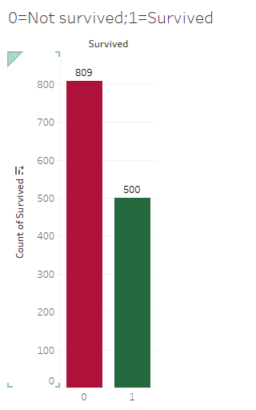
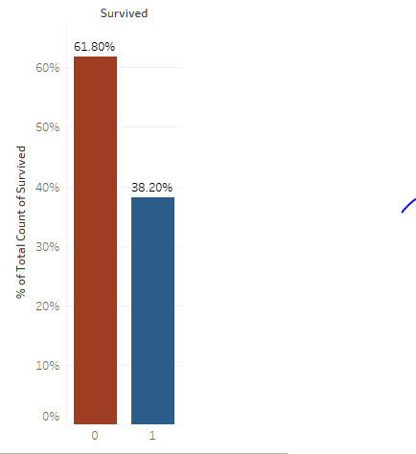
How many passengers survived?
Out of the 1,309 total passengers on board, only 38% survived the ship’s sinking.
Out of the 1,309 total passengers on board, 809 not passengers survived.
500 passengers survived.

Slide 4
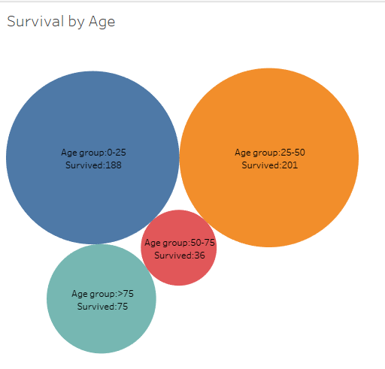
Which age group of passengers survived the most and the least?
Passengers between the age group of 25-50 survived the most.
Passengers between the age group of 50-75 survived the least.

Slide 5
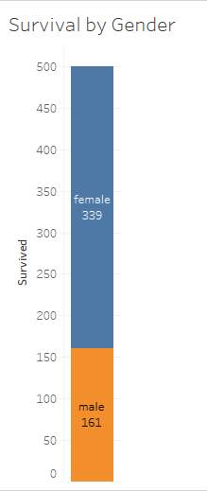
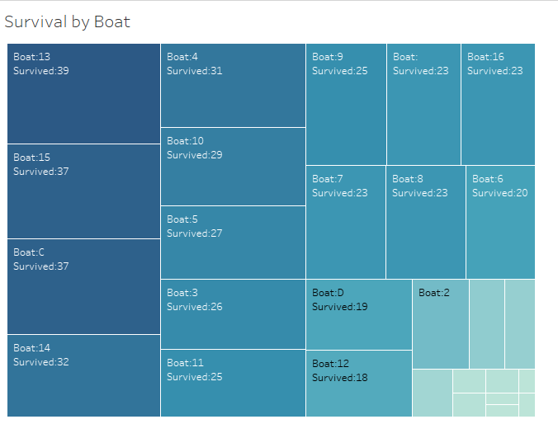
How many passengers survived as per the gender?
339 female passengers and 161 male passengers survived.
Female passengers survived the most.
Which boat has the maximum survived passengers?
Boat 13 has the most survived passengers.

Slide 6
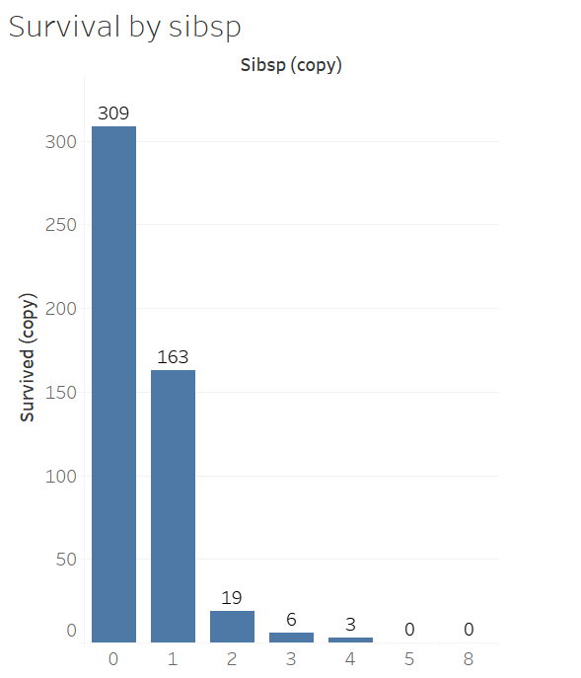
Does more no . of siblings effect the survival rate?
In this we can clearly see that survival rate of passengers is more who doesn’t have siblings
309 passengers who survived don’t have siblings in the titanic

Slide 7
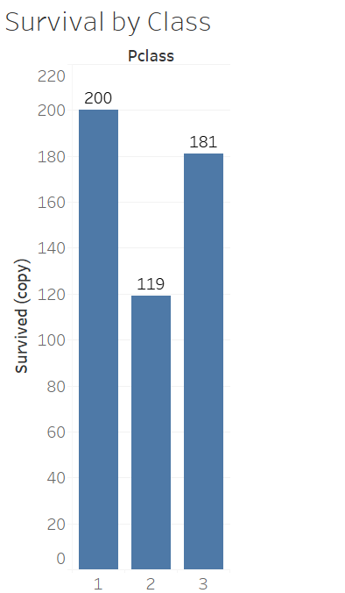
Does class effect the survival rate?
People from 1st class had more survival rate when compare to other classes

Slide 8
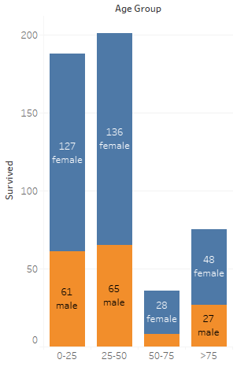
Conclusion
Overall, a person’s chance of survival was dependent on their Gender, Age, Sibsp.
we can clearly see that most people who perished were young men. Especially young men in their 20s.
Additionally, most survivors were women between 25-50 age group.
If a passenger had siblings their chance of survival decreases.

